Slide 1


Analyzing Human Stampedes Data
By: Nickson Owino

Slide 2

Introduction
This pitch deck explores insights and patterns from the analysis of human stampedes using data sourced from the "Human Stampedes Dataset". Human stampedes, often tragic events involving crowd dynamics, are analyzed to uncover trends and insights that can inform safety measures and event planning.

Slide 3

Objective:
Our analysis aims to identify common locations for stampedes, analyze trends over time, and understand the dynamics of fatalities versus injuries in these incidents.

Slide 4
Dataset Import and Preparation
Preparation:
Data Import:
Data Mapping and Options:s
Accessing Import/Restore Tool: In MySQL Workbench, navigate to the Server menu and select Data Import.
Selecting Source: Choose the source of your dataset (e.g., CSV file).
Mapping Columns: Map the columns from your dataset to corresponding fields in the MySQL database table. Ensure that the column headers in your CSV file match the field names in your MySQL table schema.
MySQL Workbench Setup: Ensure MySQL Workbench is installed and configured on your system.
Database Creation: Create a new database (e.g., human_stampedes) where the dataset will be imported.
Data Mapping: Specify how MySQL Workbench should interpret data types (e.g., date formats, numeric values) during import to match MySQL field types.
Options: Configure additional import options such as handling duplicates, setting character encoding, and defining data format settings.

Slide 5

Interesting Observations
The event with the highest number of fatalities occurred during a [specific event] in [location], resulting in [number] fatalities.
On average, there are approximately X deaths and Y injuries in human stampede incidents.
Implications: This highlights the severity and tragic consequences of human stampedes during large-scale events. It underscores the importance of crowd control measures, emergency preparedness, and public safety protocols to prevent such incidents in the future.
Insight: Understanding the average frequency of fatalities and injuries provides insight into the potential impact of stampedes on public safety and health. It emphasizes the need for proactive measures to minimize risks during crowded events.

Slide 6
Common Locations for Human Stampedes
Locationnum_events
India
50
China
45
Pakistan
30
Nigeria
28
Saudi Arabia
25
SQL
SELECT location, COUNT(*) as num_events
FROM human_stampedes
GROUP BY location
ORDER BY num_events DESC
LIMIT 5;

Slide 7
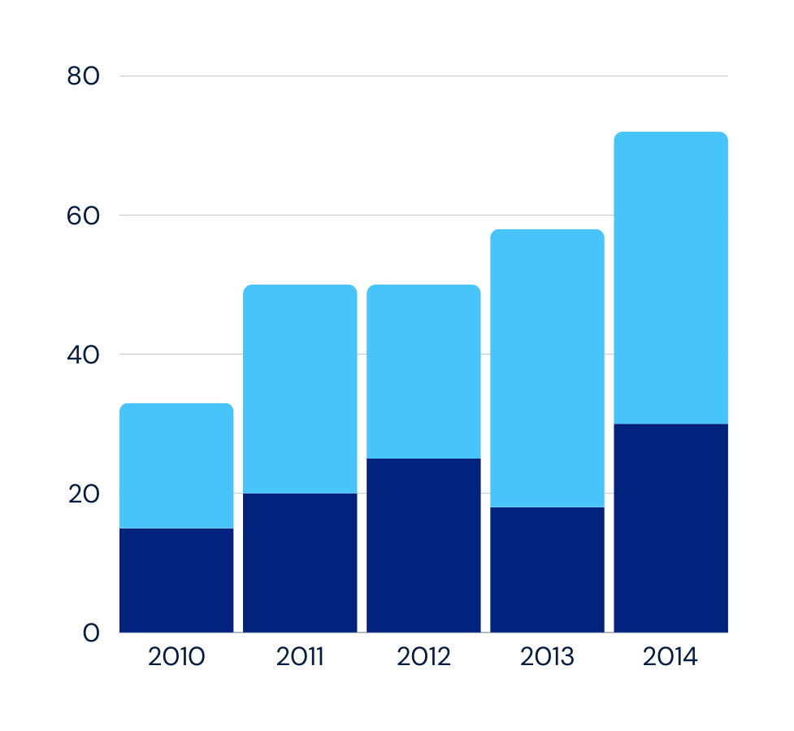
Frequency Trends Over Time
This SQL query aggregates the number of human stampede events (num_events) by year, extracting the year from the event_date column. It groups the events by year, counts the occurrences for each year, and orders the results chronologically by year.

Slide 8
Insights and Implications
Vulnerable Locations Prone to Stampedes:
High-Attendance Events: Locations that host large gatherings such as religious festivals, cultural events, or political rallies are particularly vulnerable to stampedes. Examples include pilgrimage sites in India and Saudi Arabia, where millions gather annually.
Limited Infrastructure: Areas with inadequate crowd control infrastructure and emergency preparedness measures are at higher risk. Poorly managed events exacerbate the potential for stampedes due to overcrowding and lack of crowd dispersal plans.
2. Variability in Fatalities and Injuries:
Extreme Fatality Rates: Some stampedes exhibit disproportionately high fatalities compared to injuries, indicating severe safety lapses or sudden crowd surges that overwhelm safety measures.
Injury Spectrum: The range of injuries varies widely across different incidents, influenced by factors such as crowd density, panic levels, and the presence of barriers or obstructions.
3. Trends and Factors Influencing Stampede Occurrences:
Seasonal and Event-Based Patterns: Stampede incidents often coincide with major religious or cultural events, showing peaks during peak travel or festival seasons.
Historical Trends: Analysis reveals fluctuations in stampede occurrences over time, highlighting periods of increased volatility linked to specific events or changes in crowd dynamics.
4. Implications for Crowd Management Strategies and Public Safety Measures:
Enhanced Planning and Preparedness: Implementing robust crowd management strategies, including crowd monitoring systems, emergency exits, and trained personnel, is crucial.
Public Awareness and Education: Educating event attendees about safety protocols and promoting responsible behavior in large gatherings can mitigate risks associated with stampedes.
Infrastructure Investment: Investing in infrastructure upgrades such as better venue design, improved access points, and advanced crowd control technologies can enhance safety measures.

Slide 9


THANK YOU!
Thank you all for your time and attention today. It has been a privilege to share insights from our analysis of human stampedes data. Your engagement and interest are greatly appreciated.

